Slide 1


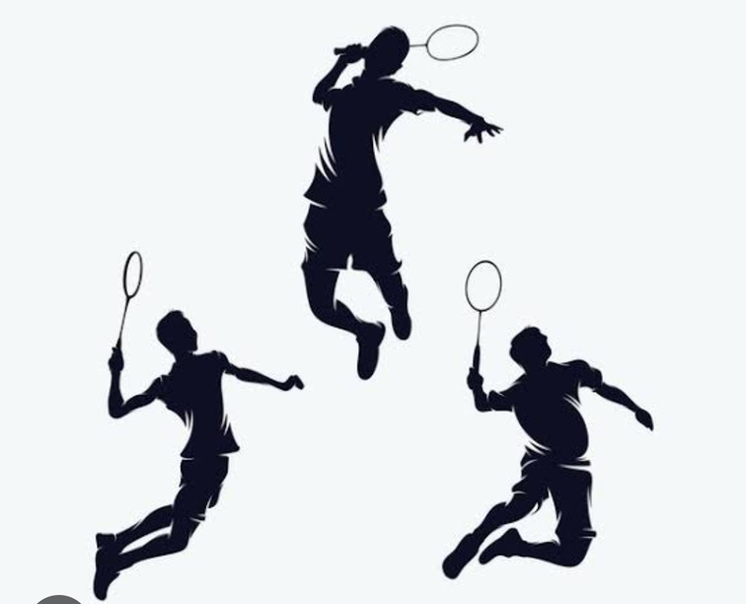
GEU BADMINTON TOURNAMENT
GEU Sports Ltd.
Group: I
Group members: Prachi Rawat
Kashish Kumar
Krishna Garg
Drishti Juyal
Mayank Singh

Slide 2
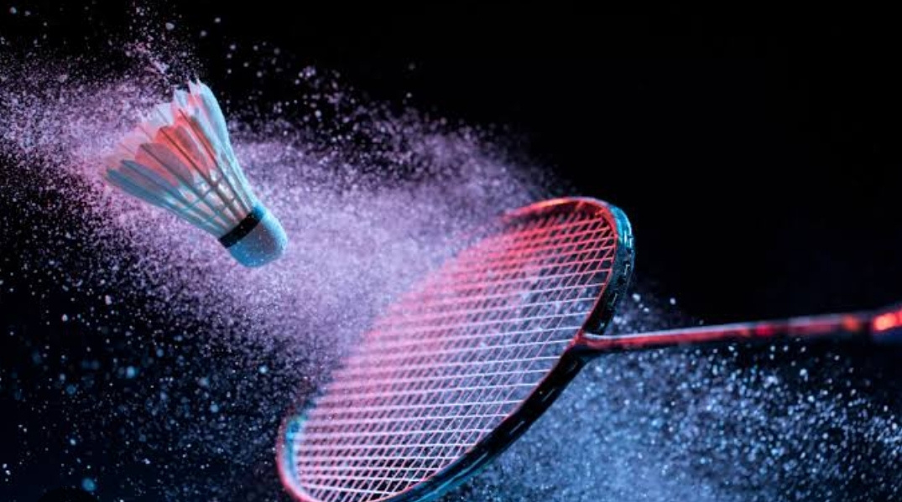
Introduction
Welcome to the thrilling world of badminton! Our upcoming tournament promises intense rallies, strategic plays, and fierce competition. Join us as players showcase their agility and skill on the court, vying for victory and the title of badminton champion. Get ready for a fast-paced spectacle filled with smashes, drops, and incredible athleticism. May the best shuttlecock soar to success in this exciting badminton tournament!

Slide 3
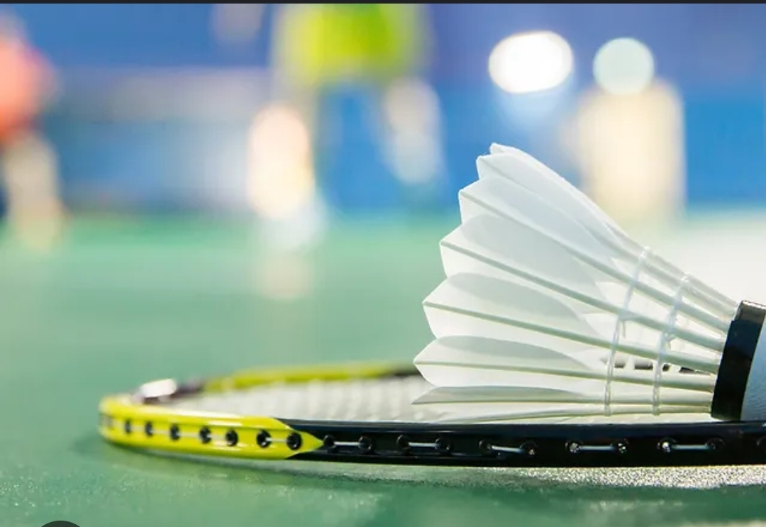
Tournament
Type : Domestic BAI
Type Dates Tournament Title Venue Website Venue
BAI 28 Nov - 05 Dec 2023 Graphic era deemed Junior Sub Junior (U-15 & U-17) Ranking Badminton Tournament 2023 at Graphic era , Haldwani
BAI 21 Nov - 24 Nov 2023 Yonex-Sunrise 35th Sub Junior (U-13) National Badminton Championships 2023 at Graphic era Hill, Dehradun
BAI 21 Nov - 27 Nov 2023 Yonex-Sunrise All India Junior (U-19) Ranking Badminton Tournament 2023 Graphic era ,Bhimtal
BAI 15 Nov - 18 Nov 2023 Yonex-Sunrise 2nd Mini (U-11) National Badminton Championships 2023 Graphic era deemed, Dehradun

Slide 4
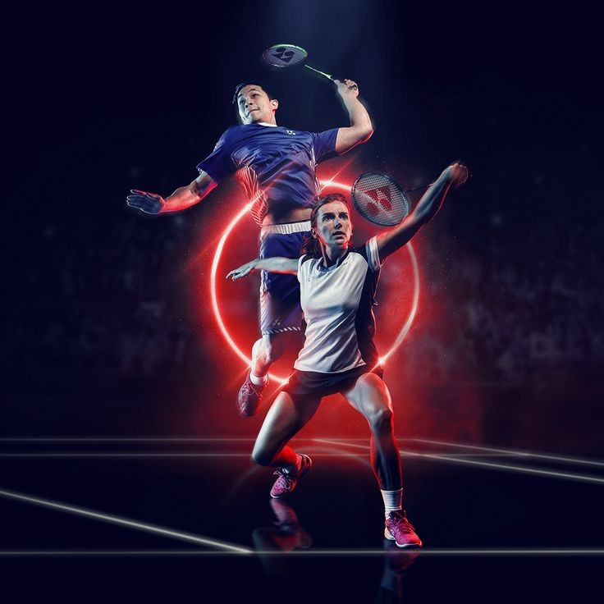

PLAYER'S AGE
#include <stdio.h>
int main() {
char name[50];
int age;
printf("Enter your name: ");
scanf("%s", name);
printf("Enter your age: ");
scanf("%d", &age);
if (age >= 18 && age <= 25) {
printf("Welcome, %s!\n", name);
printf("Entry fees: Rs 250\n");
// Collect entry fees (assuming payment process here)
printf("Thank you for participating!\n");
} else {
printf("Sorry, you are not eligible to participate.\n");
}
return 0;
}

Slide 5
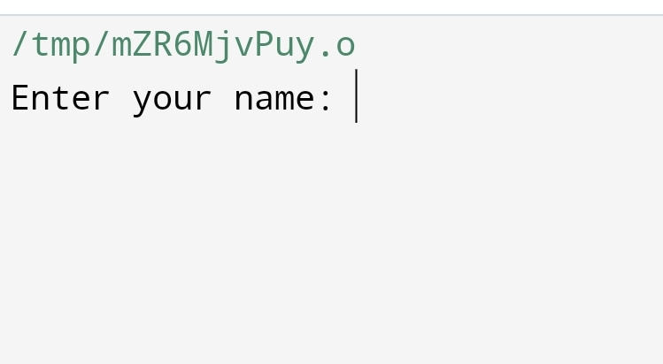
Output we get

Slide 6
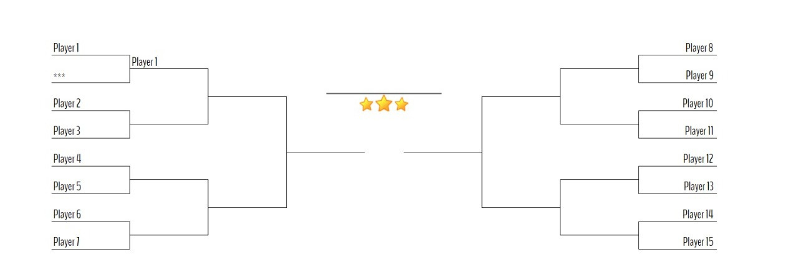
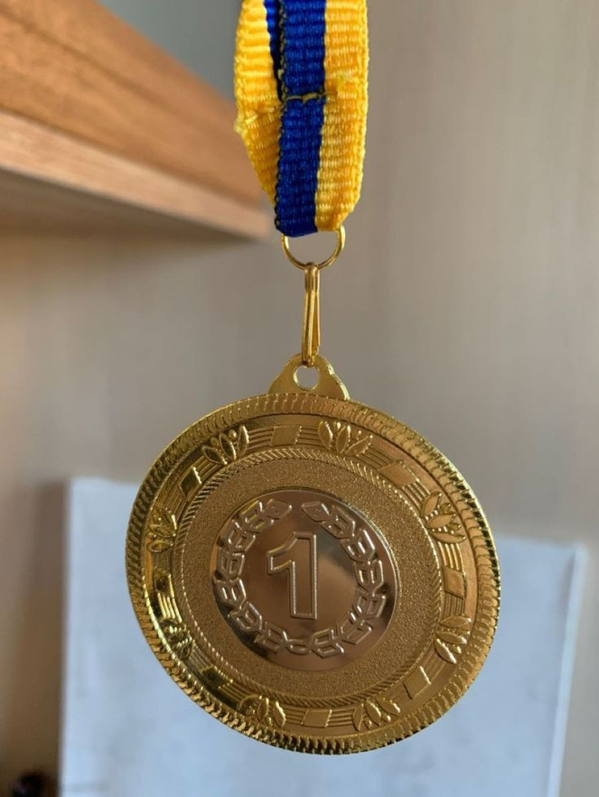
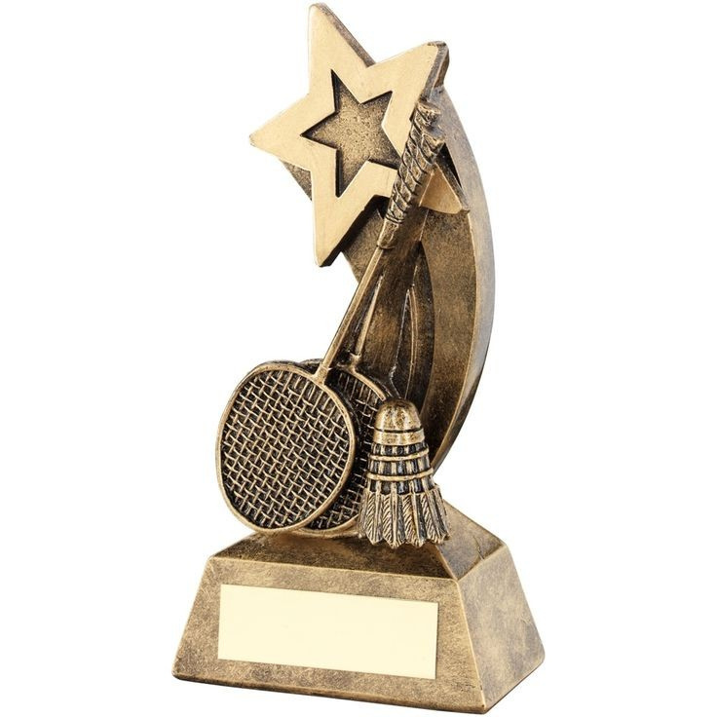
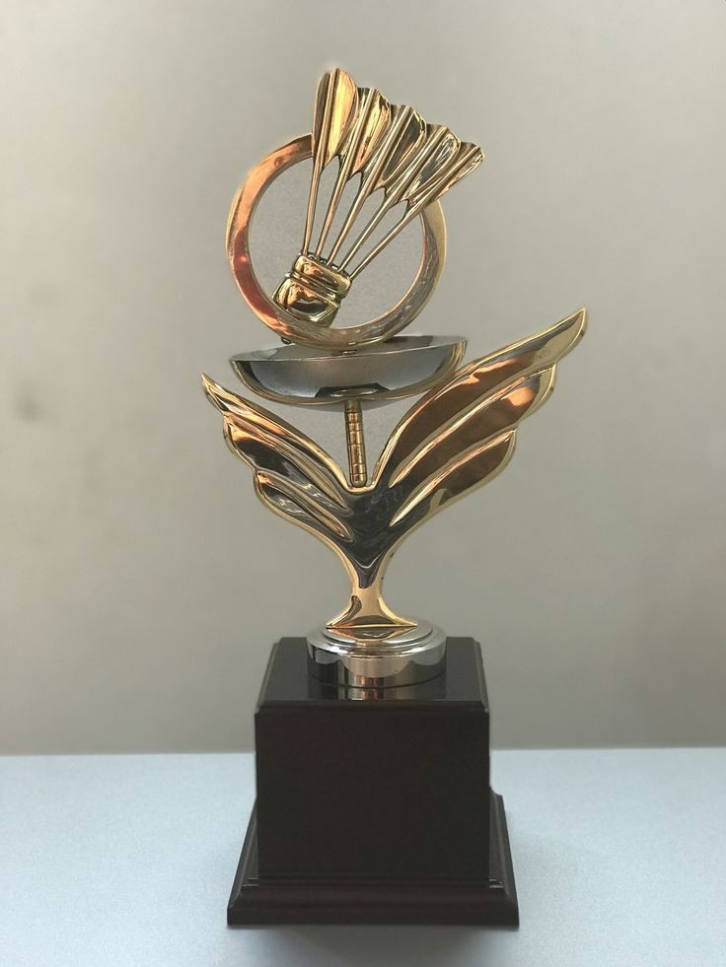
GIRLS BADMINTON CHAMPIONSHIP
ROUND -1

Slide 7
GIRLS BADMINTON CHAMPIONSHIP
ROUND -2

Slide 8
BOYS BADMINTON CHAMPIONSHIP
ROUND -1

Slide 9
BOYS BADMINTON CHAMPIONSHIP
ROUND -2

Slide 10
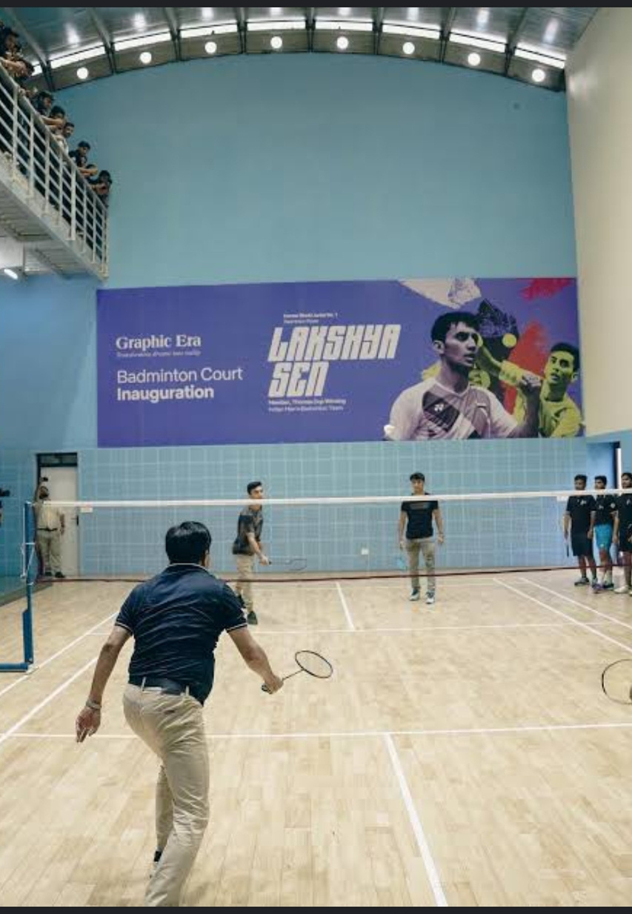
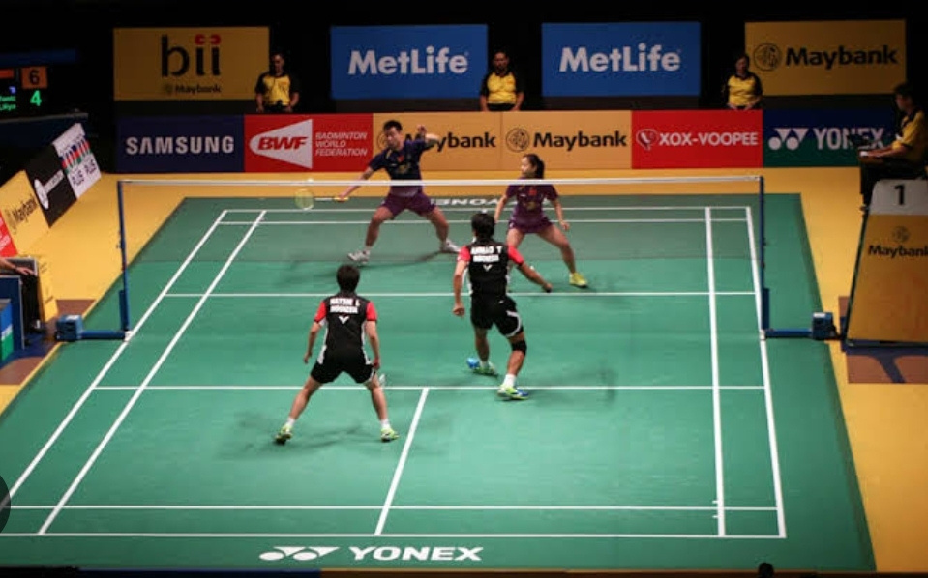
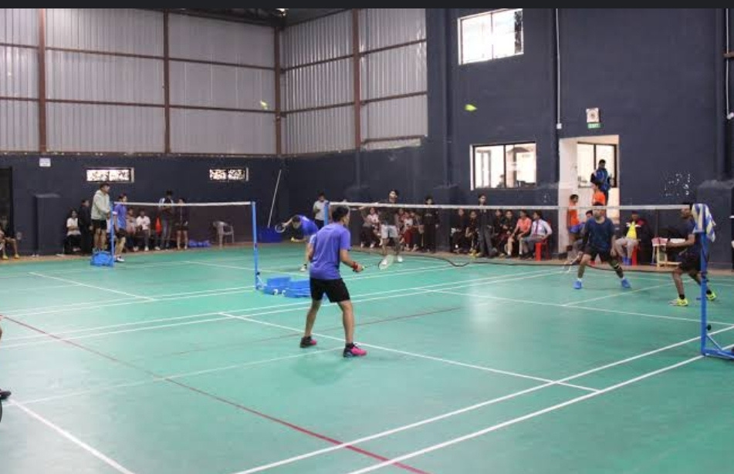
BADMINTON COURT

Slide 11
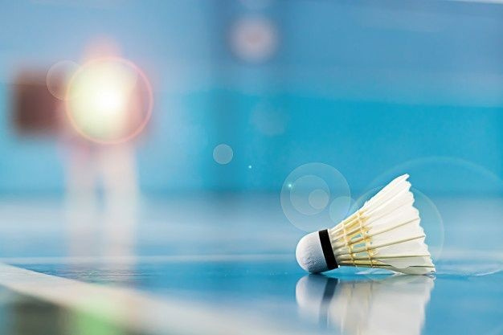
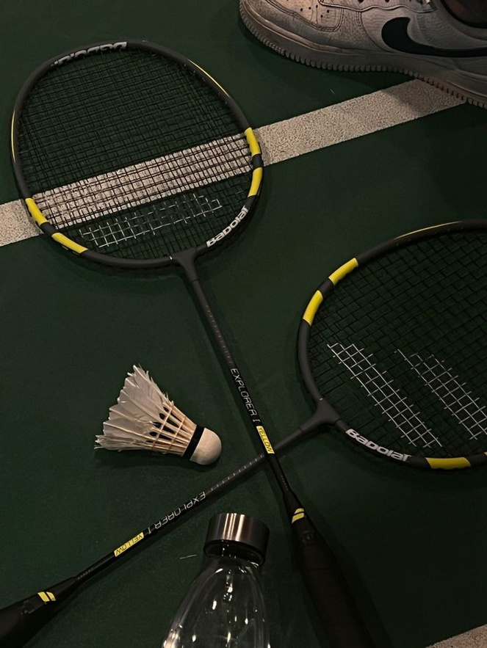

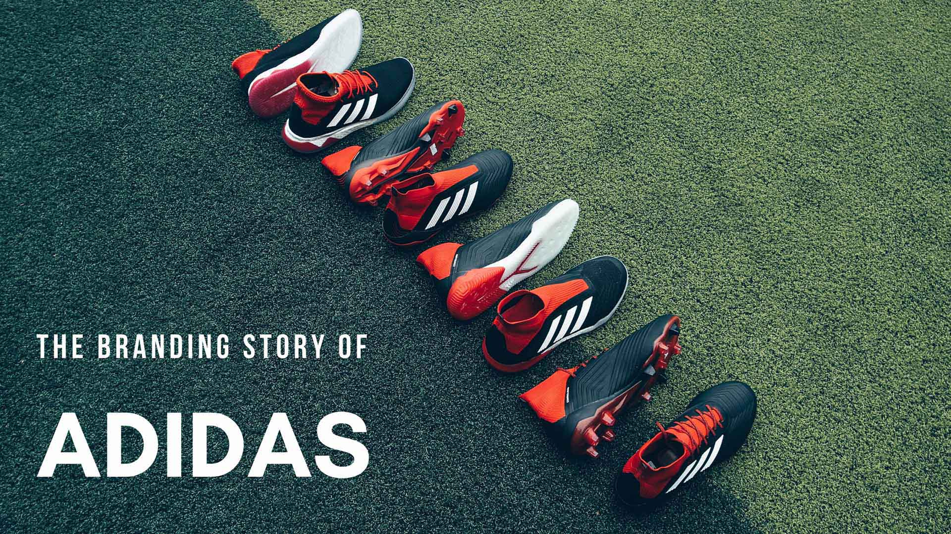
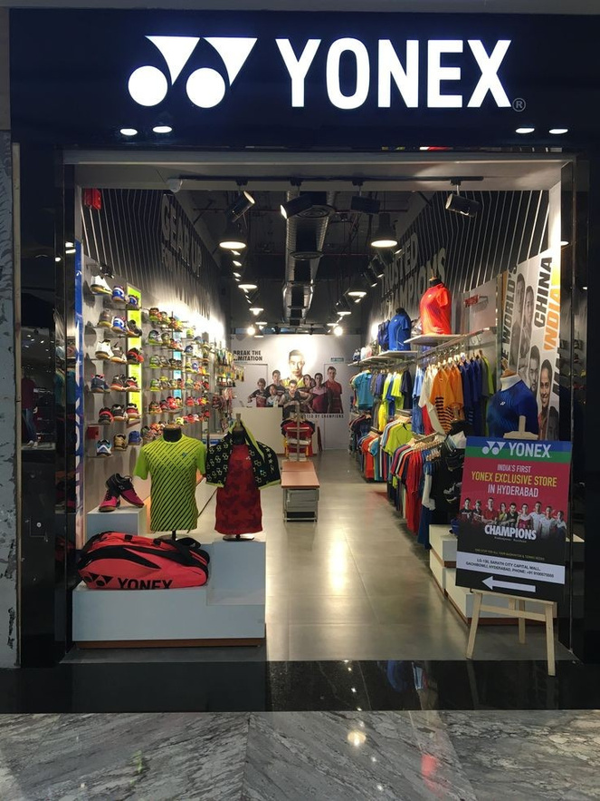
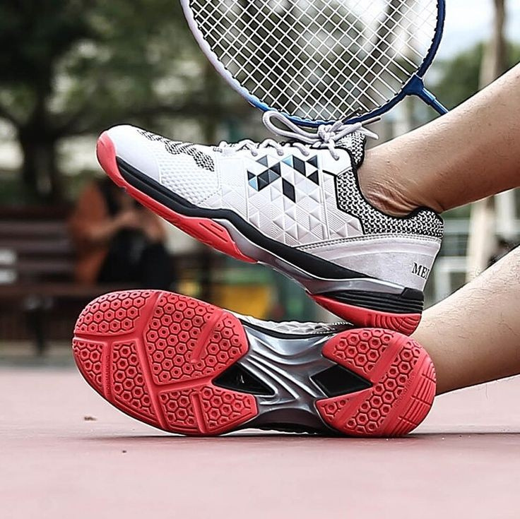
Sports material requirements
#include <stdio.h>
int main() {
int badmintonRacketsPerMatch = 2;
int shuttlecocksPerMatch = 6;
int pairsOfShoesPerMatch = 2;
int totalEquipment = badmintonRacketsPerMatch + shuttlecocksPerMatch + (pairsOfShoesPerMatch * 2);
printf("Total number of badminton equipment needed for a match: %d\n", totalEquipment);
return 0;
}

Slide 12
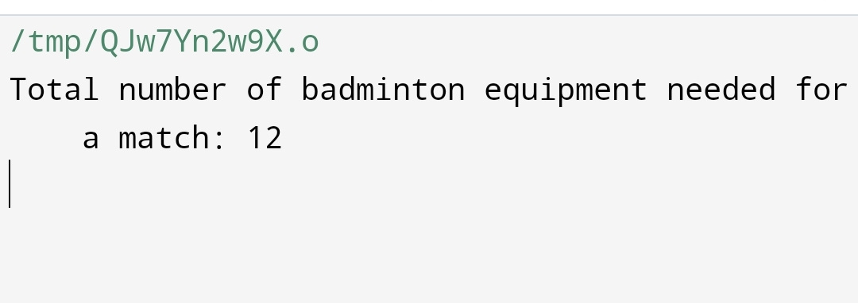
Output we get

Slide 13
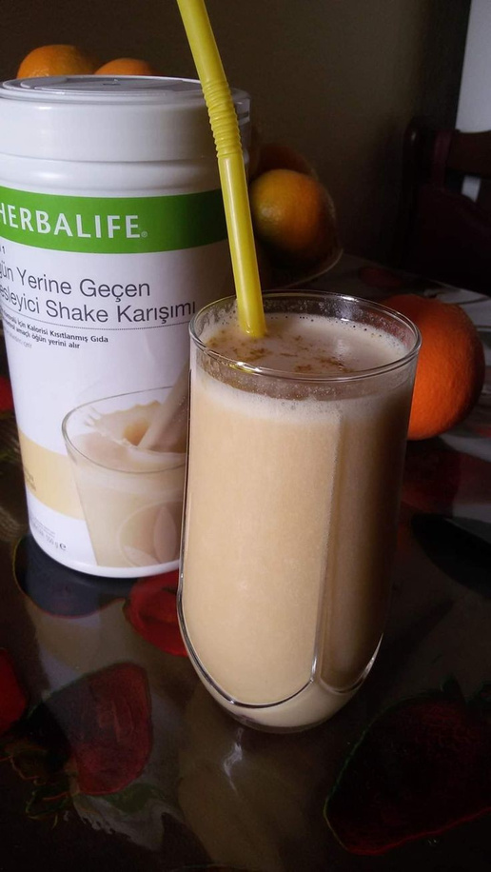

Menu for players
#include <stdio.h>
int main() {
char menu[20][50];
for (int day = 0; day < 20; day++) {
printf("Enter the menu for Day %d: ", day + 1);
scanf("%s", menu[day]);
}
printf("\nMenu for 20 days:\n");
for (int day = 0; day < 20; day++) {
printf("Day %d: %s\n", day + 1, menu[day]);
}
return 0;
}

Slide 14
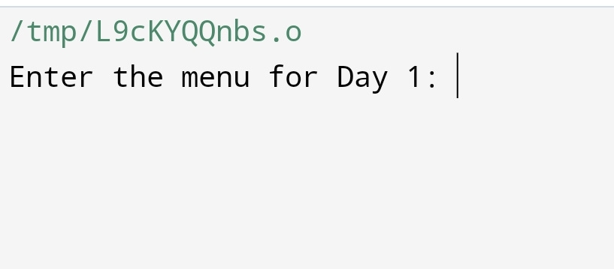
Output we get

Slide 15


COMPANIES ENTRY
#include <stdio.h>
int main() {
int choice;
printf("Welcome to the Badminton Tournament!\n");
printf("Enter the type of sponsor:\n");
printf("1. Sports Companies\n");
printf("2. Sporting Goods Companies\n");
printf("3. Health Companies\n");
scanf("%d", &choice);
switch (choice) {
case 1:
printf("Sports Companies:\n");
printf("1) Yonex\n");
printf("2) Li-Ning\n");
printf("3) Adidas\n");
break;
case 2:
printf("Sporting Goods Companies:\n");
printf("1) Decathlon\n");
printf("2) Sports Direct\n");
break;
case 3:
printf("Health Companies:\n");
printf("1) Herbalife\n");
printf("2) Nutrilite\n");
break;
default:
printf("Invalid choice!\n");
}
printf("\n Thankyou ❤️");
return 0;
}

Slide 16
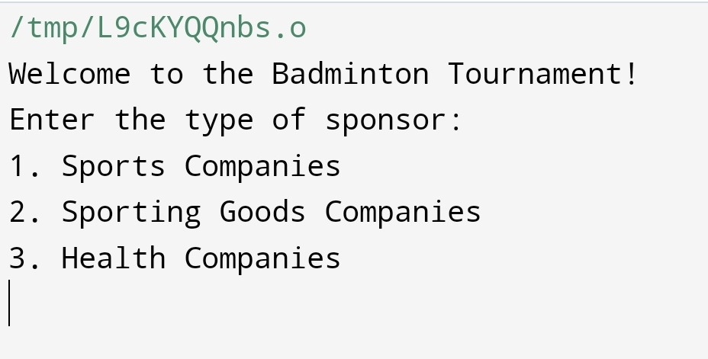
Output we get

Slide 17

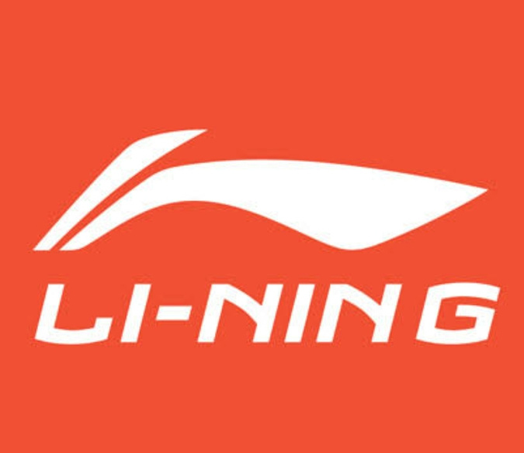
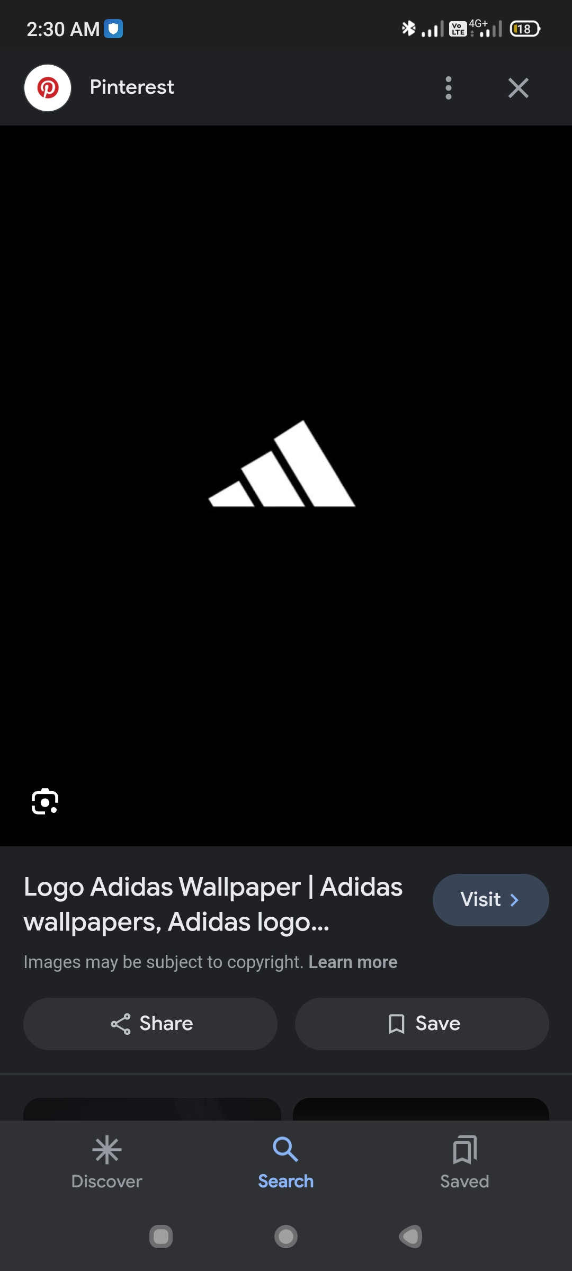
Sponsored
By
(Sports Brands)
Yonex
Li-ning
Adidas

Slide 18
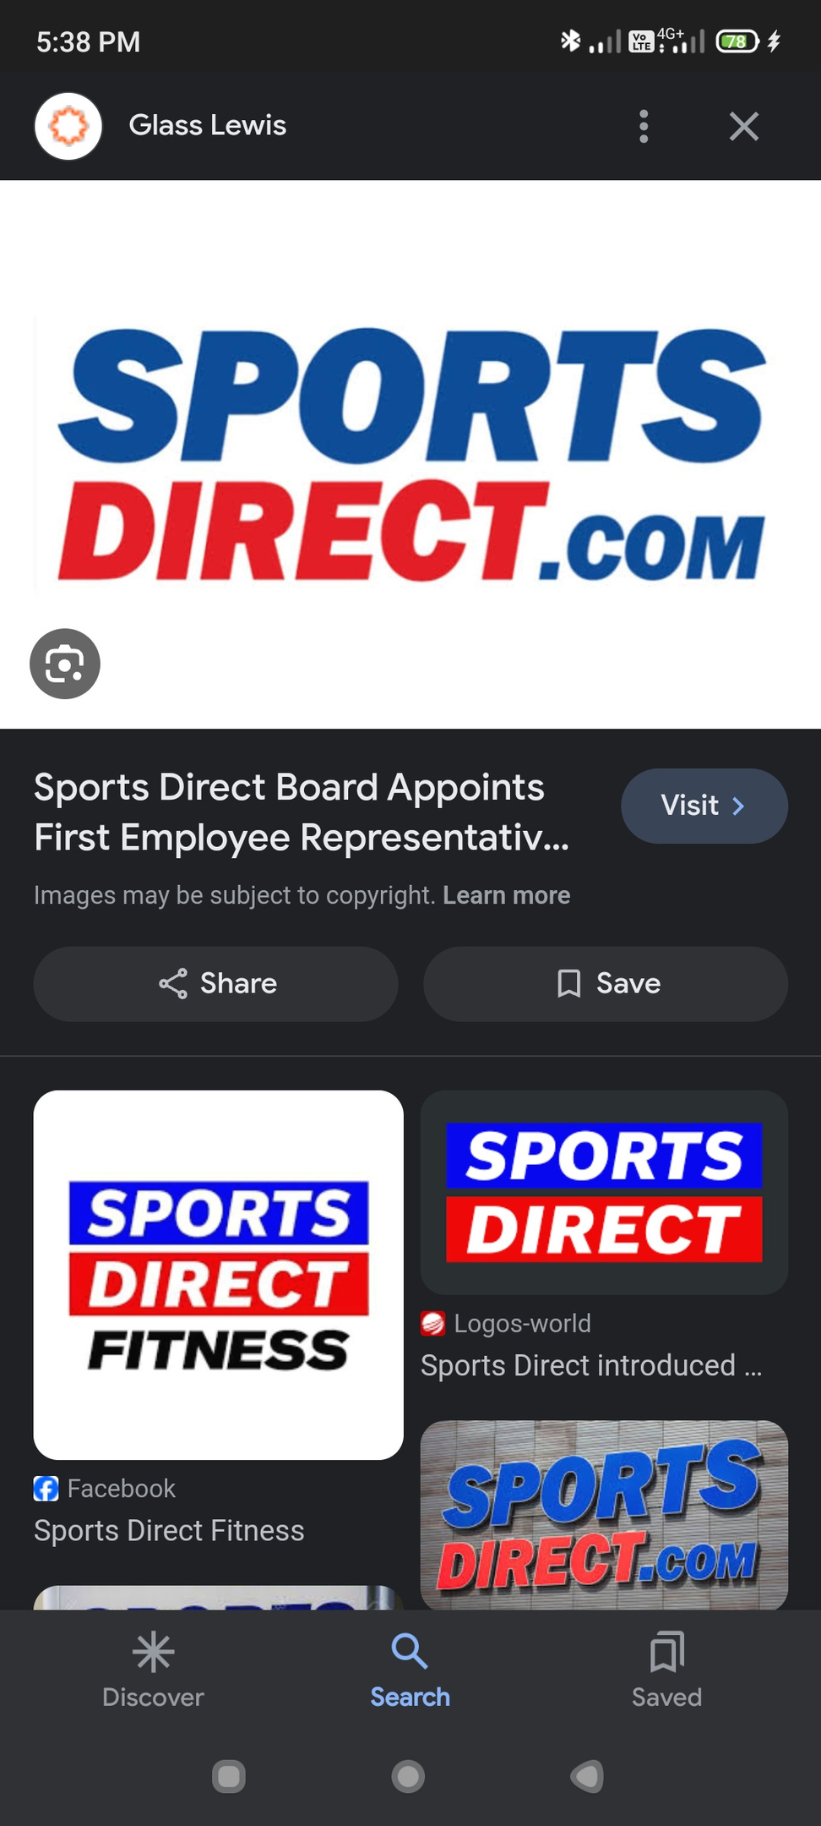

Sponsored
By
(Sporting goods retailers)
Decathlon
Sports direct

Slide 19


Sponsored
By
(Health and wellness companies)
Herbalife
Nutrilite

Slide 20
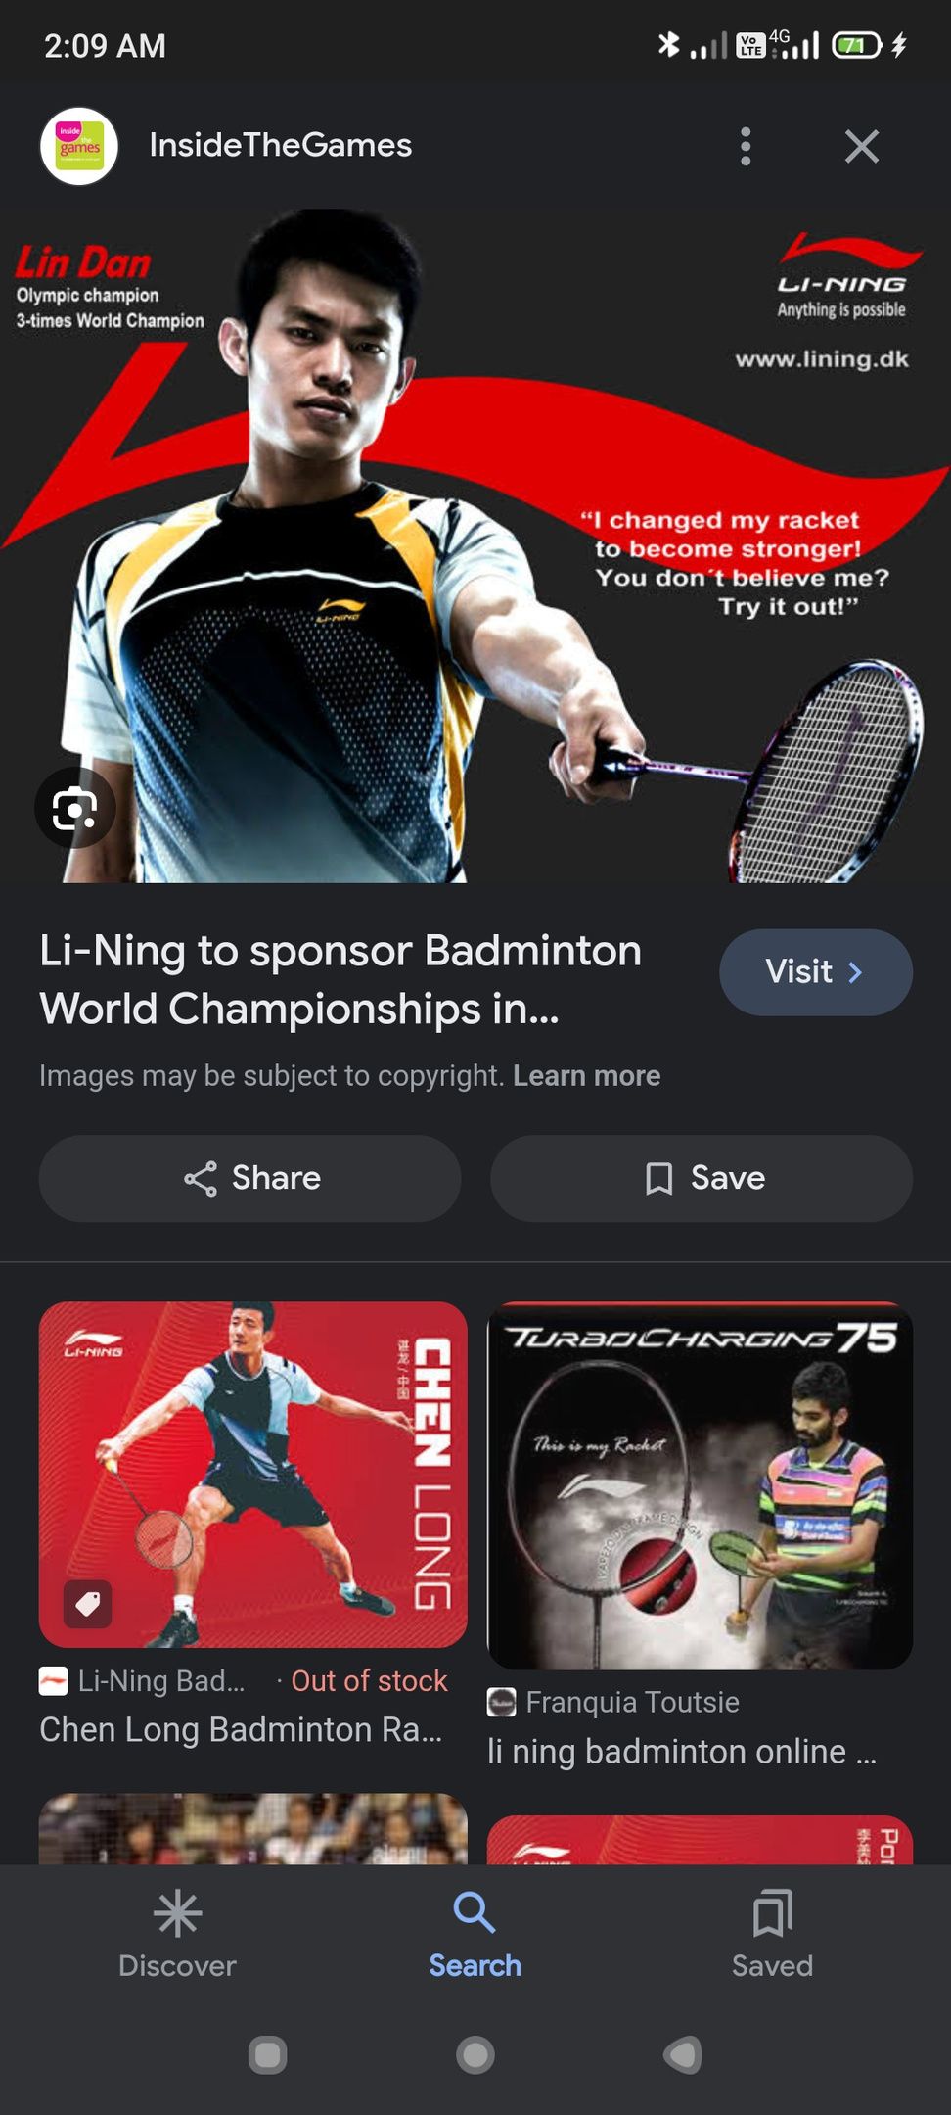
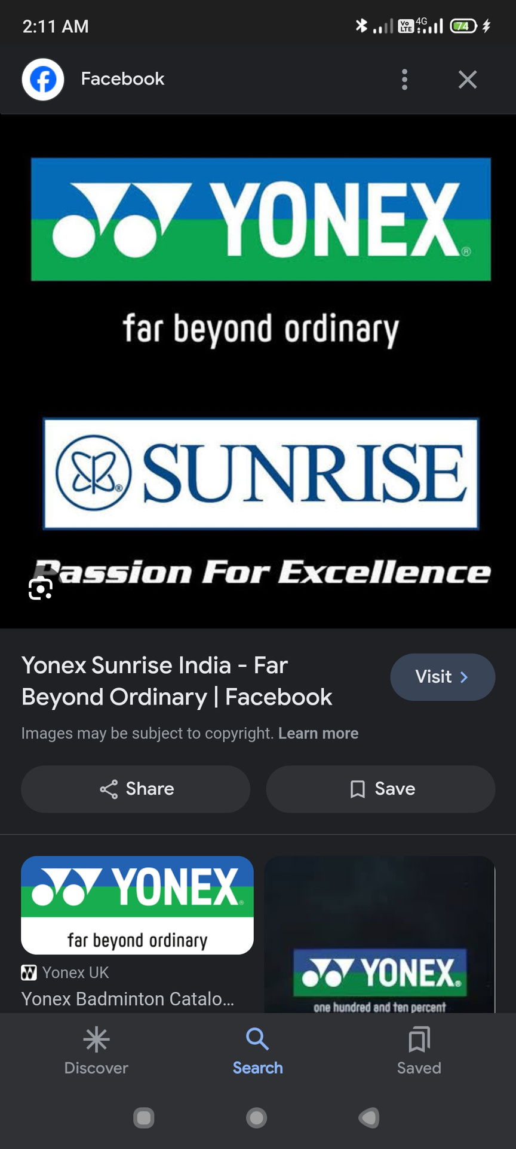
Li-Ning Company Limited is a Chinese sportswear and sports equipment company founded by former Olympic gymnast Li Ning. The company endorses a number of athletes and teams worldwide.
Yonex is a Japanese sports equipment manufacturing company. Yonex produces equipment and apparel for tennis, badminton, golf, and running.

Slide 21
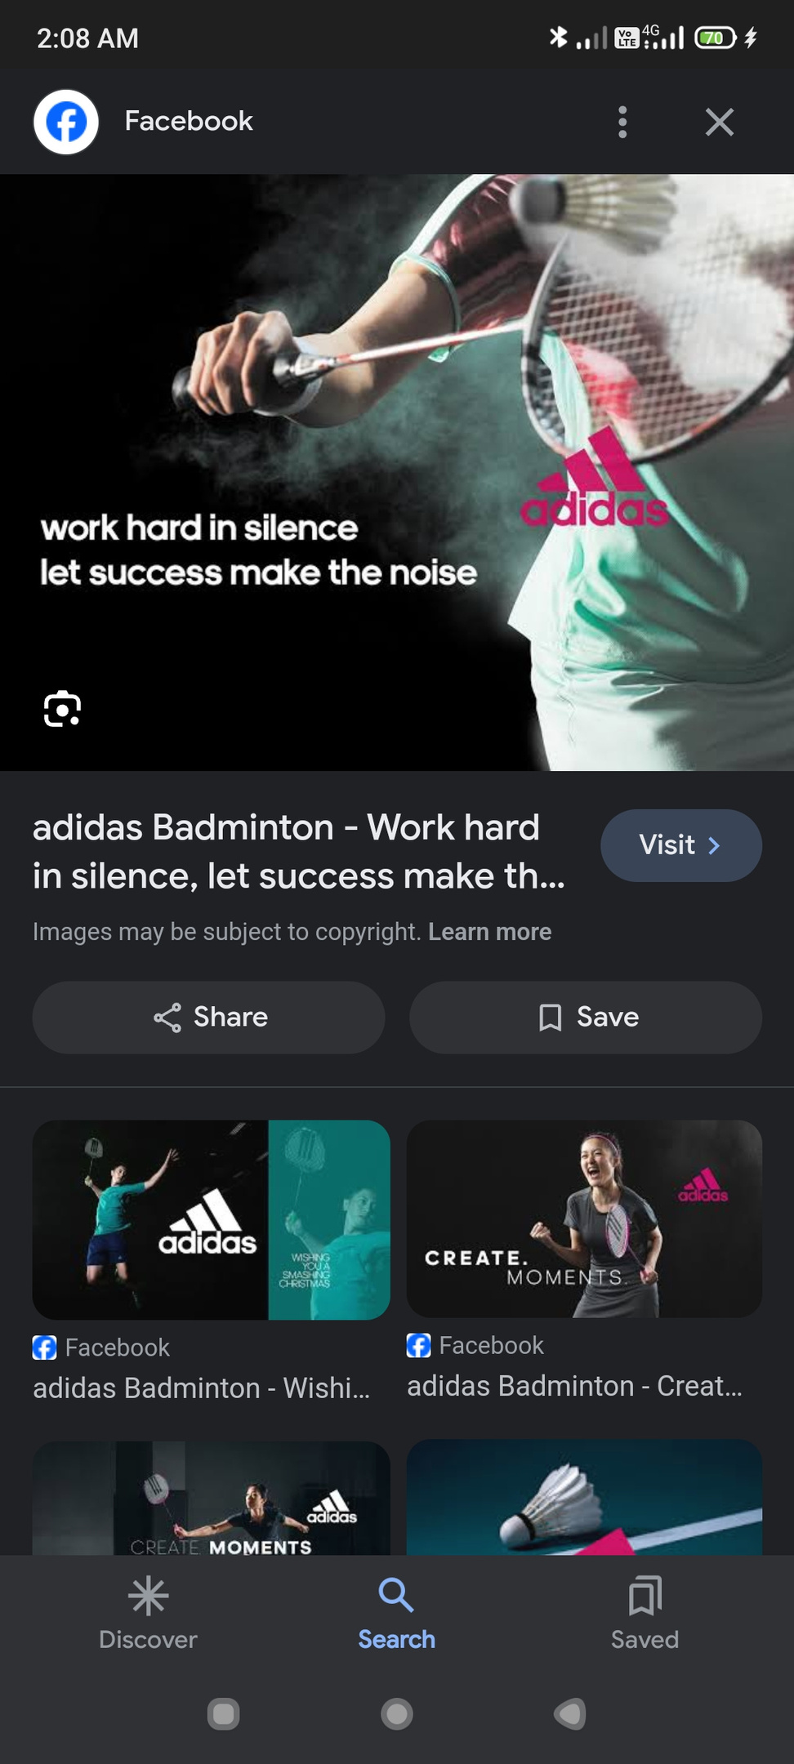

Adidas AG is a German athletic apparel and footwear corporation headquartered in Herzogenaurach, Bavaria, Germany. It is the largest sportswear manufacturer in Europe
Decathlon is a French sporting goods retailer. With over 2,080 stores in 56 countries and regions (2023),it is the largest sporting goods retailer in the world

Slide 22


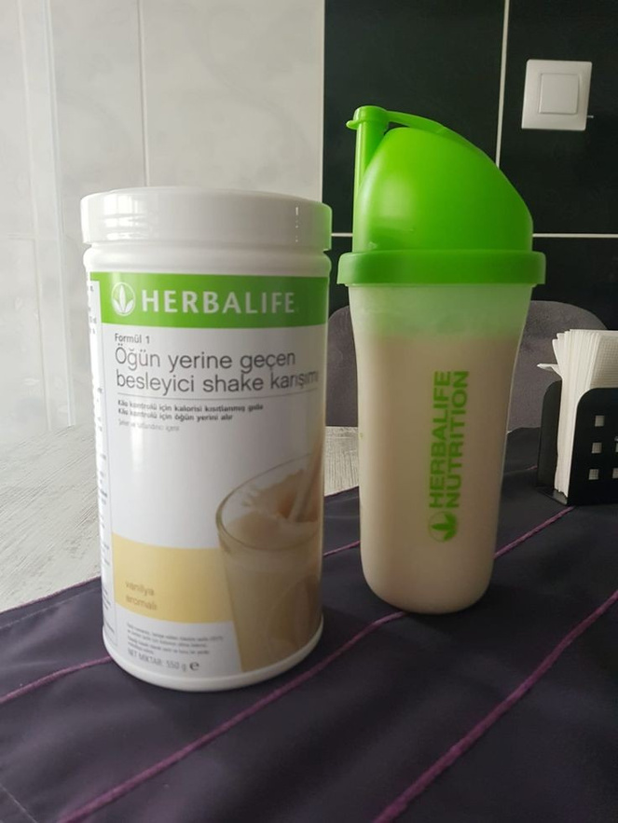
Founded in 1982, Sports Direct International PLC is today the UK's largest sporting good retailer, and operates a diversified portfolio of sports, fitness, fashion and lifestyle fascias and brands
Herbalife Nutrition Ltd., also called Herbalife International, Inc. (with a U.S. subsidiary called Herbalife International of America) or simply Herbalife, is a global multi-level marketing (MLM) corporation that develops and sells dietary supplements.

Slide 23

Nutrilite is a brand of mineral, vitamin, and dietary supplements developed in 1934 by Carl F. Rehnborg. Nutrilite products are currently manufactured by Access Business Group, a subsidiary of Alticor whose products are sold via Amway worldwide
The Nutrilite brand is known as Nutriway in Denmark, Finland, Norway, Sweden, Turkey, Australia and New Zealand

Slide 24
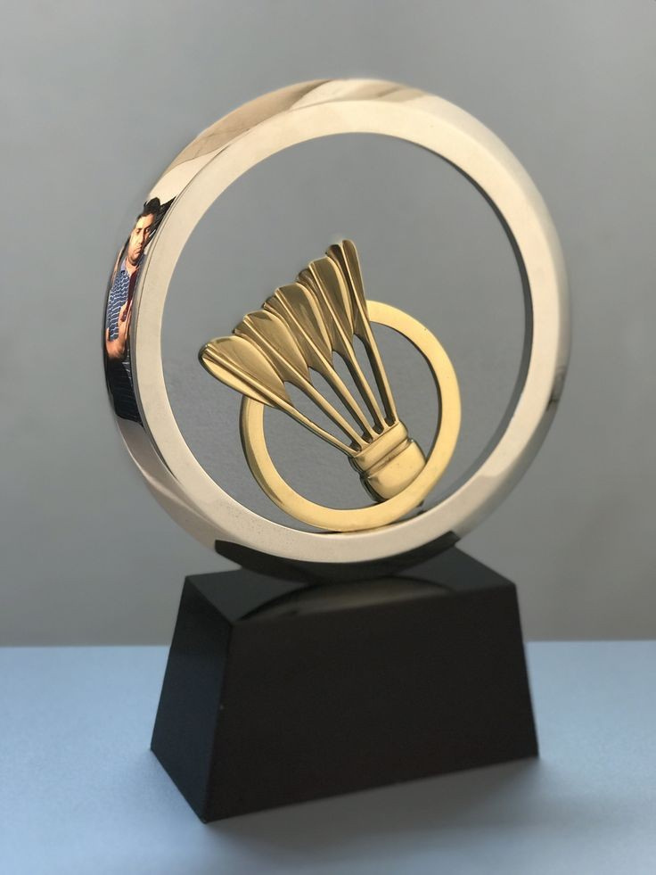

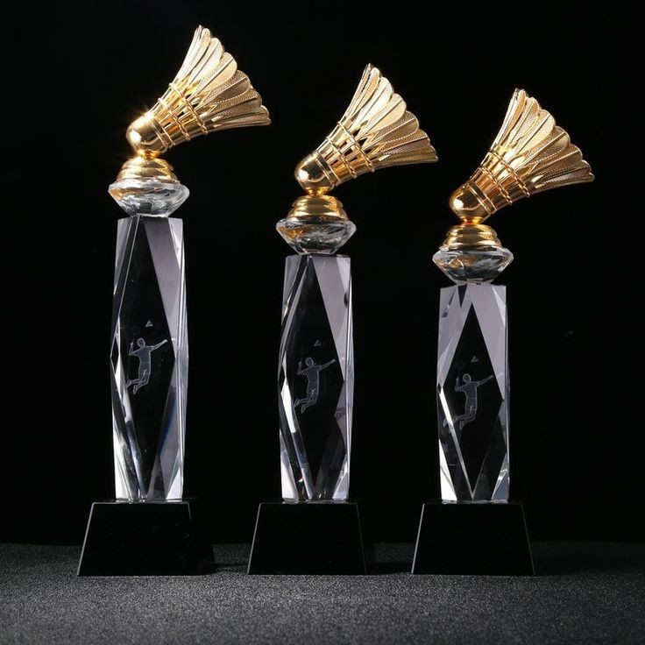
PRIZES FOR WINNERS
#include <stdio.h>
int main() {
int totalAmount = 200000;
int goldAmount = 30000;
int silverAmount = 15000;
int bronzeAmount = 5000;
printf("Gold Medalist: ₹%d\n", goldAmount);
printf("Silver Medalist: ₹%d\n", silverAmount);
printf("Bronze Medalist: ₹%d\n", bronzeAmount);
return 0;
}

Slide 25
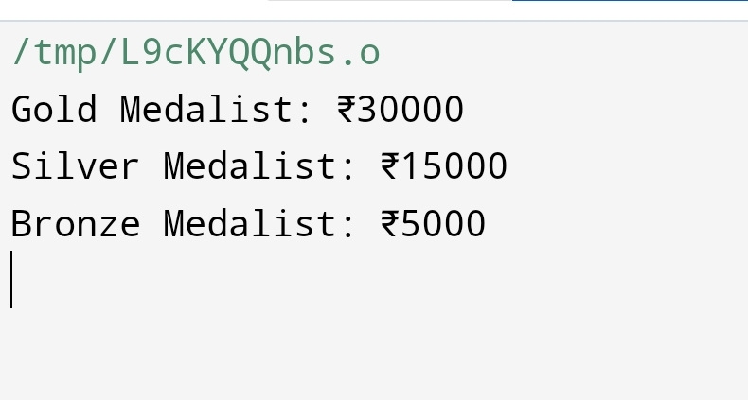
Output we get

Slide 26
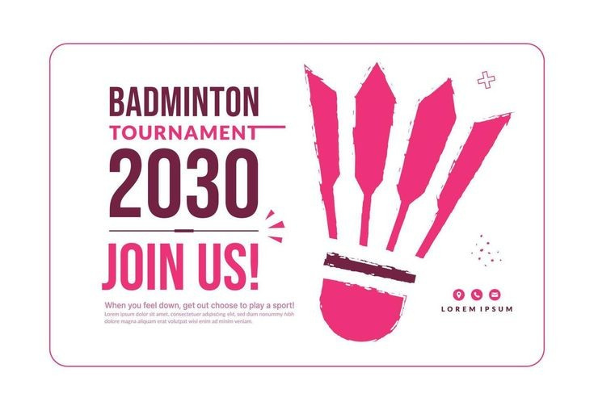
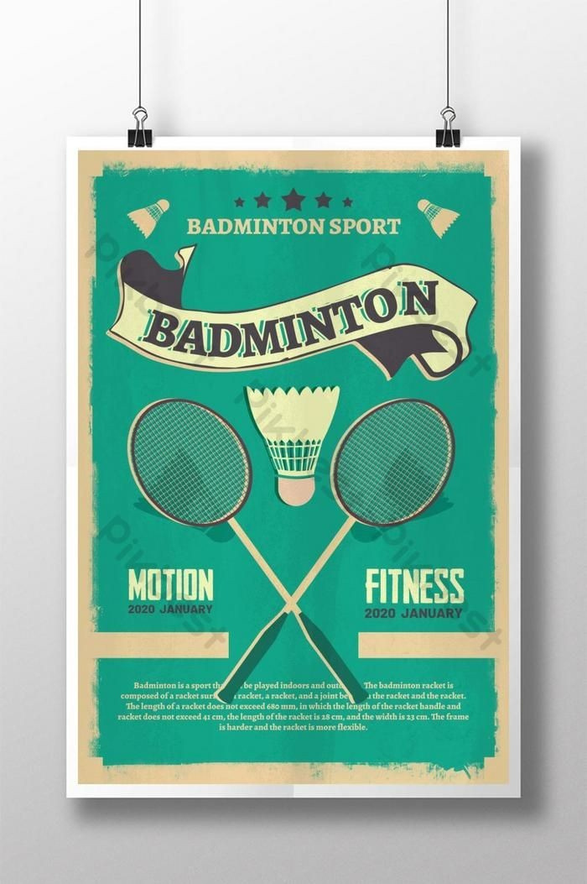


SHOW YOUR TALENTS
AND TAKE THE TROPHY
Exciting rewards

Slide 27

THANKYOU FOR JOINING AND BEING A PART OF US
Keep visiting for more exciting events

